Slide 1
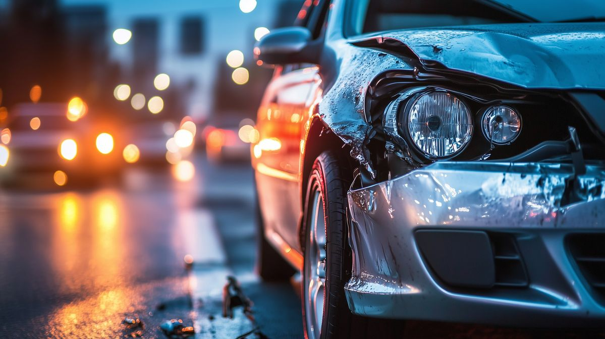



What are the main explicative factors of a car accident ?
Sixtine FREUSLON,Rafael LEVY,Mugisha SAMUEL,Marie FOUSSARD–LE MEUR

Slide 2
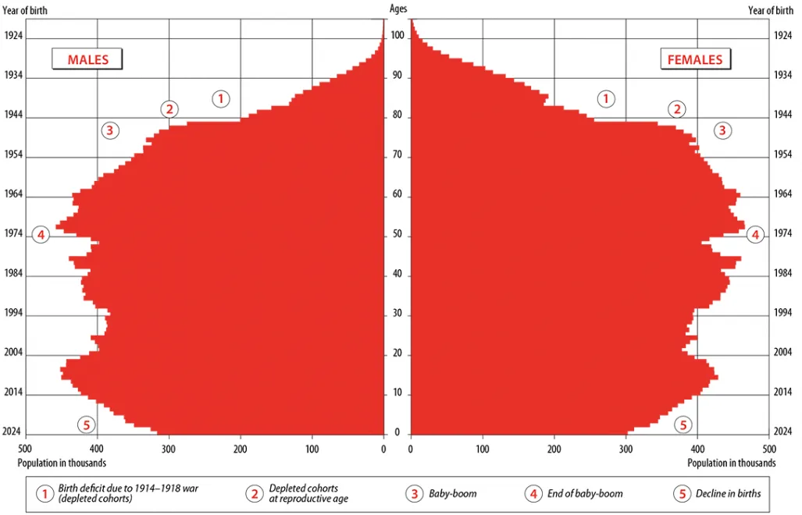
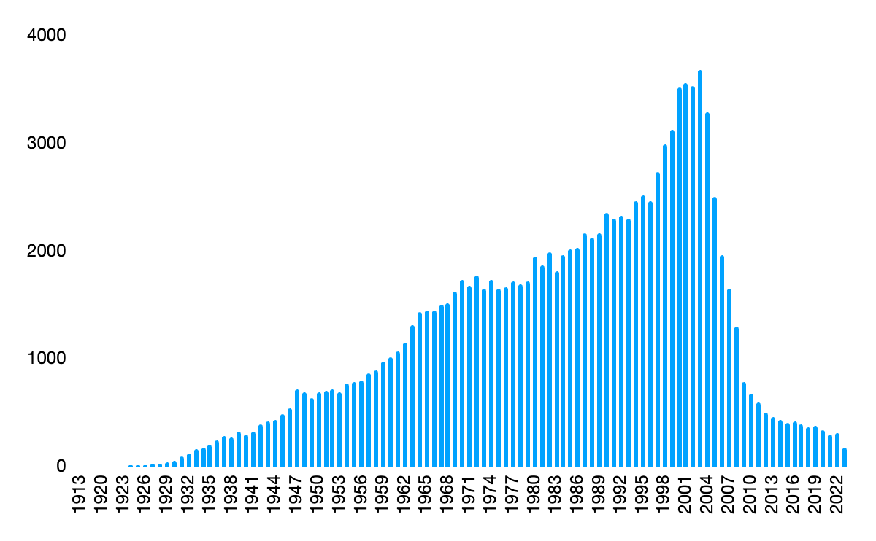
The Age of the driver
4000
Age of person involved in accident in 2023
France demographic in 2023

Slide 3
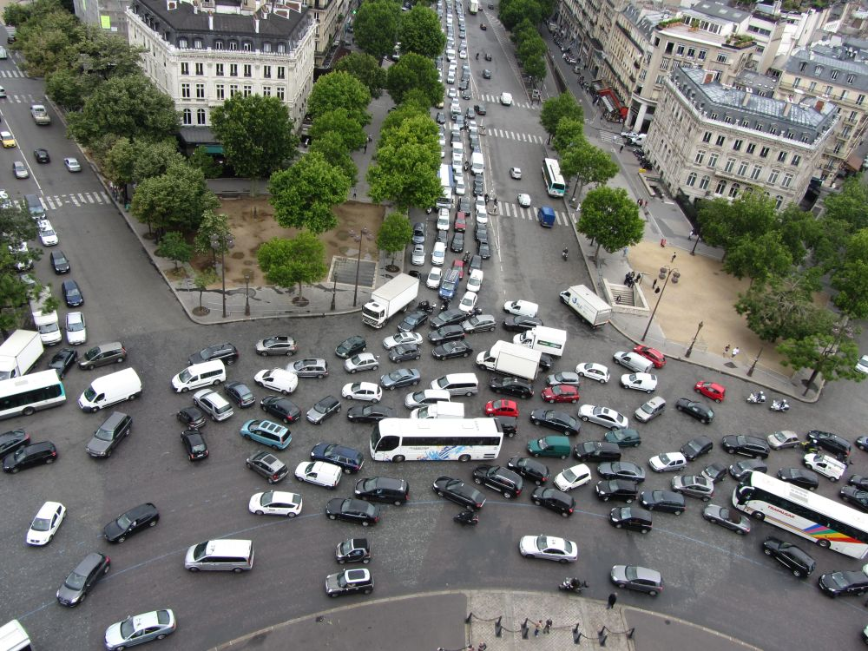

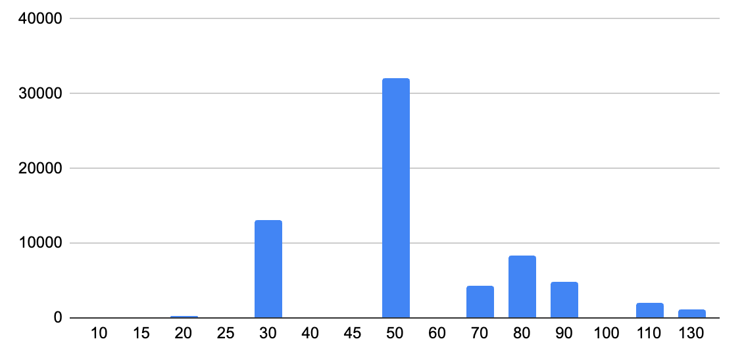
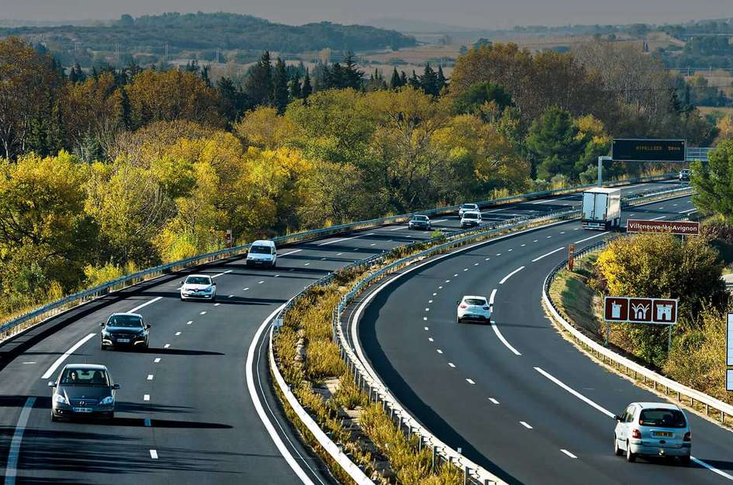

Environment
Maximum speed authorized on the accident location

Slide 4
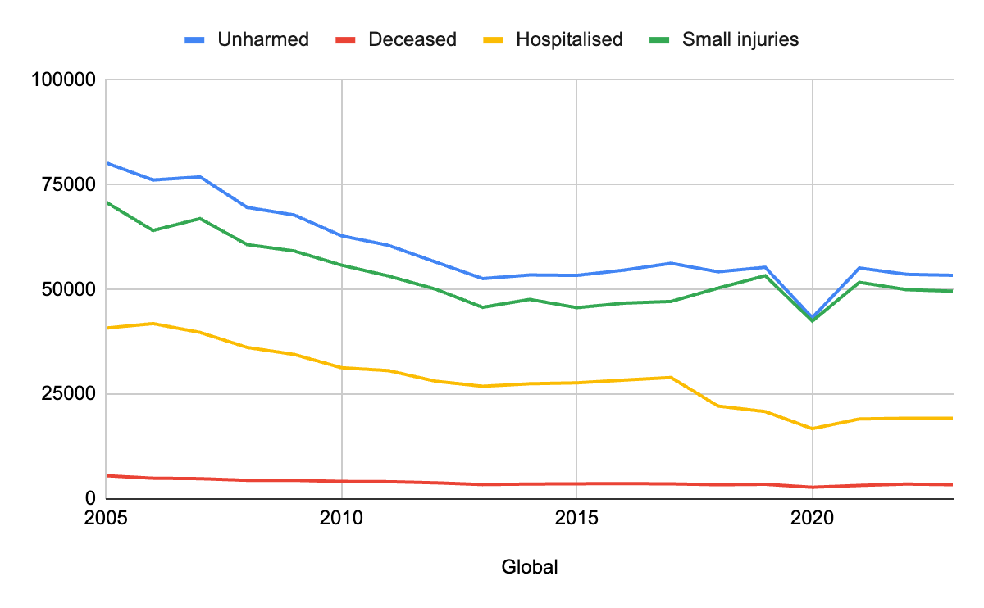
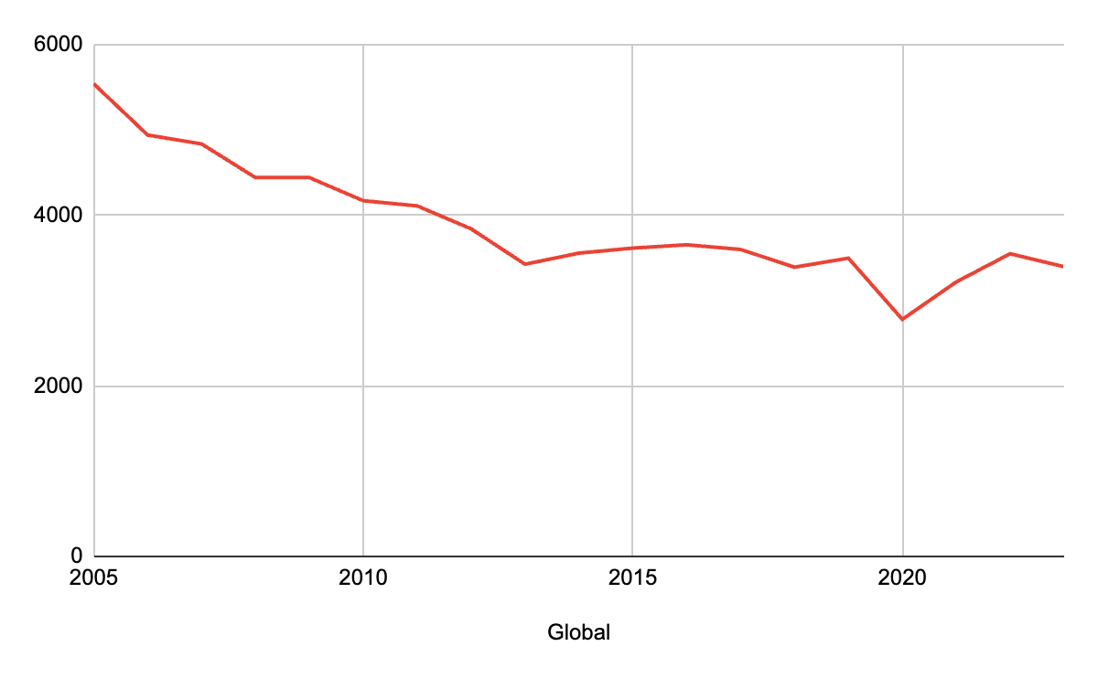
Speeding
Categories of accident between 2005 and 2023
Categories of accident between 2005 and 2023
Number of deceased between 2005 and 2023

Slide 5
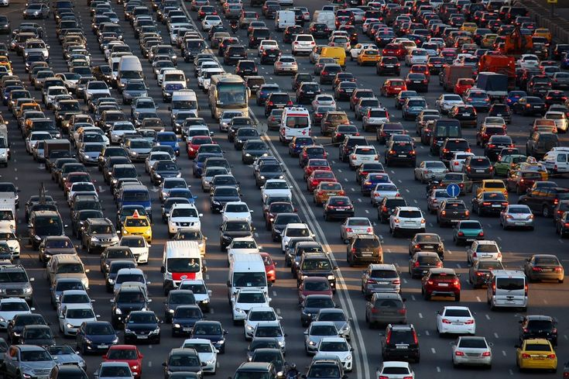






Limits of this approach ?
Distracted driving
Manufacturing deffect
Fatigue
Pedestrian error
Weather
Under the influence

Slide 6
Why are car crash not happening ?
150 crashes per day
40 millions vehicles per day

Slide 7
Accident as the reflection of the inability to face a complex situation

Slide 8
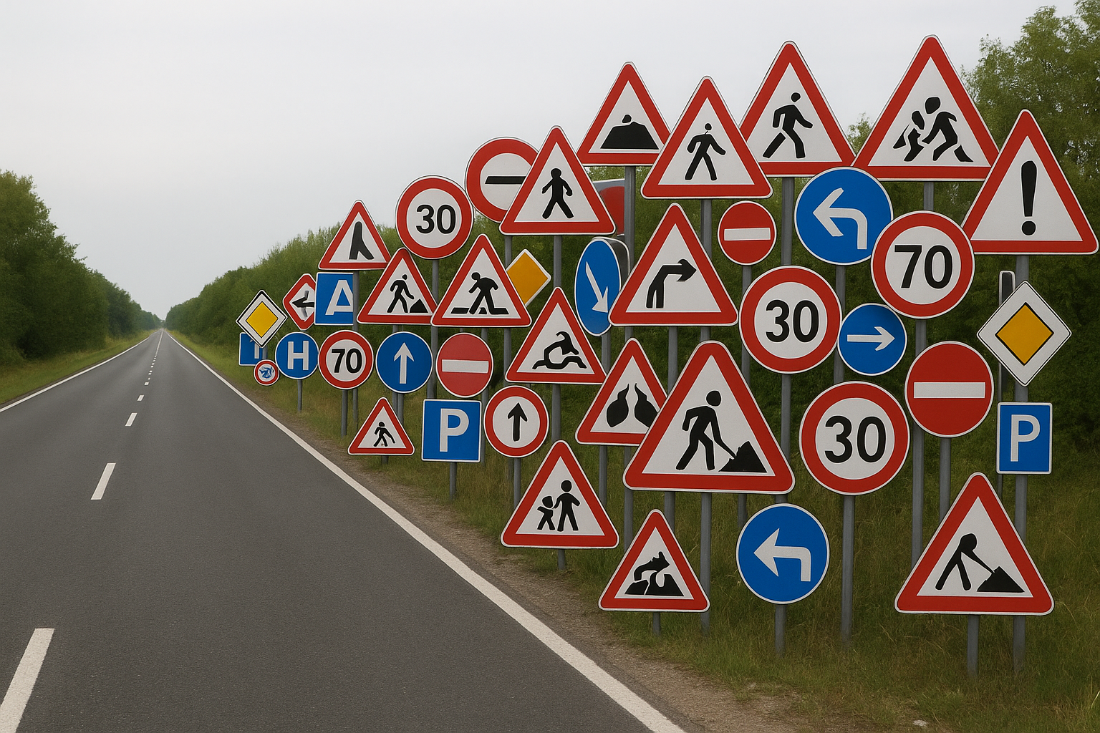
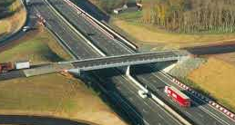
What makes a measure good?

Slide 9
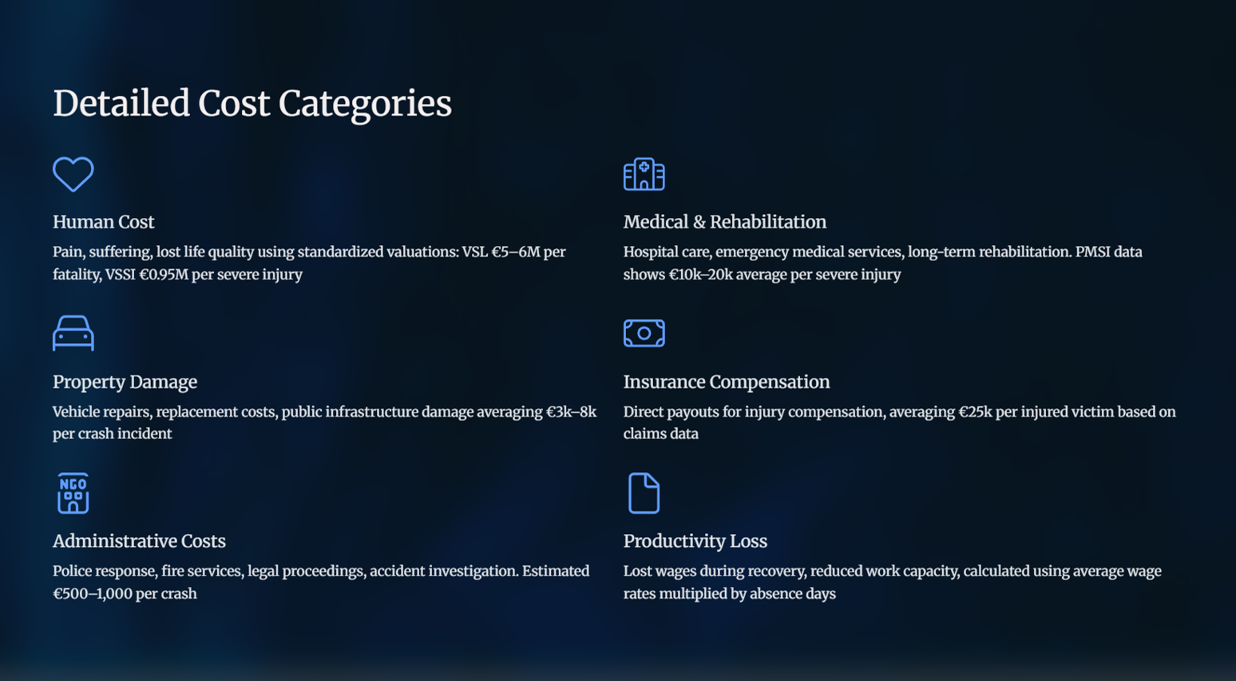

Slide 10
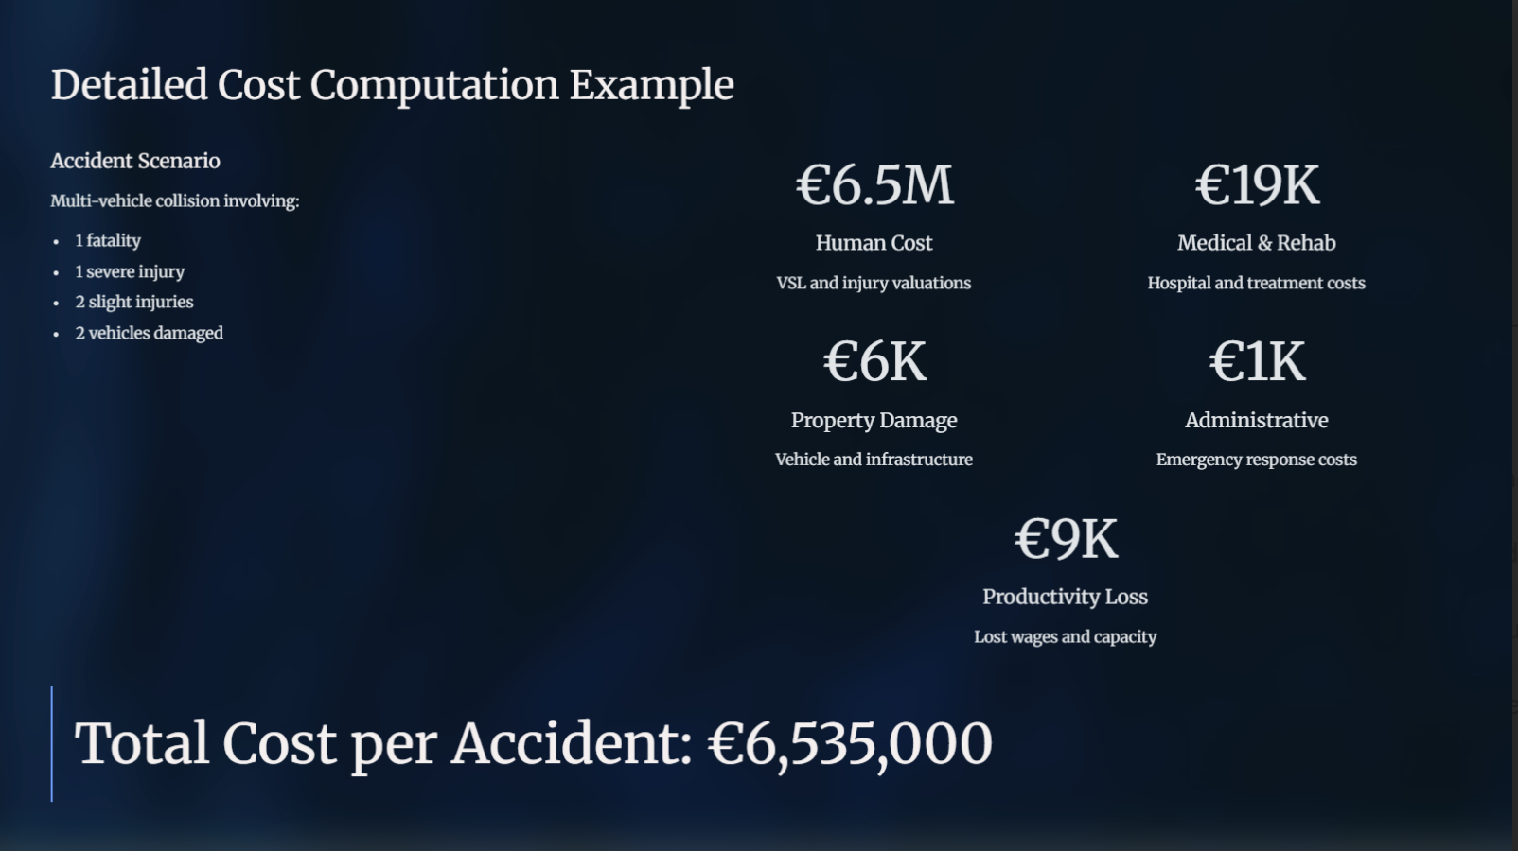
COST

